Slide 1



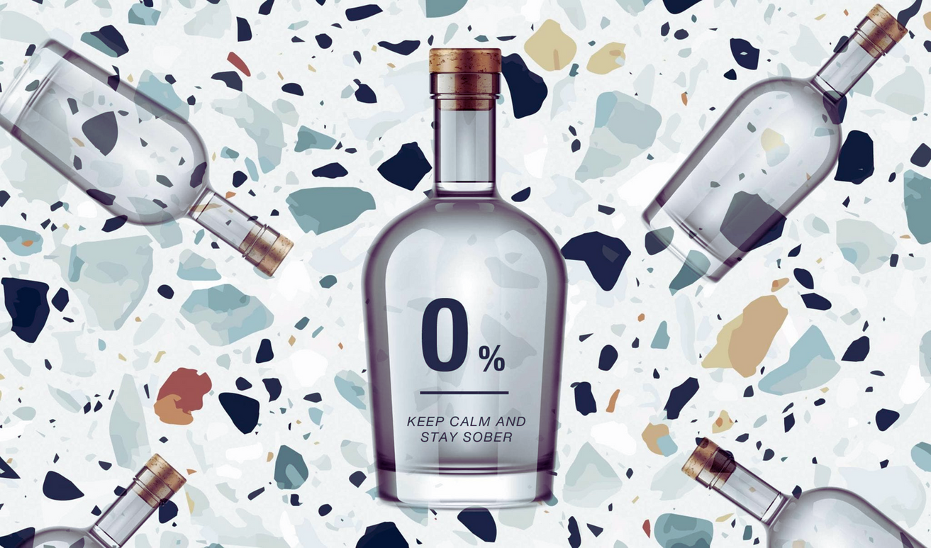

Company Name
In Singapore
|
JYOTIT KAUSHAL
Automatic video captions available.
| 15ᵗʰ APRIL 2024

Slide 2
Agenda
Big Picture – Non-alcoholic spirit market and macro scenario
Deep-dive: Scoping venues good fit for ‘Boozeless’
Top 20-25 priority venues for launch
Insights to marketing activities for roll-out
Important note: Data has been sourced from brief document, Statista, MMR and Globaldata and few other open data sources for this presentation and need to be correlated for correct interpretation

Slide 3
Agenda
Big Picture – Non-alcoholic spirit market and macro scenario
Deep-dive: Scoping venues good fit for ‘Boozeless’
Top 20-25 priority venues for launch
Insights to marketing activities for roll-out

Slide 4

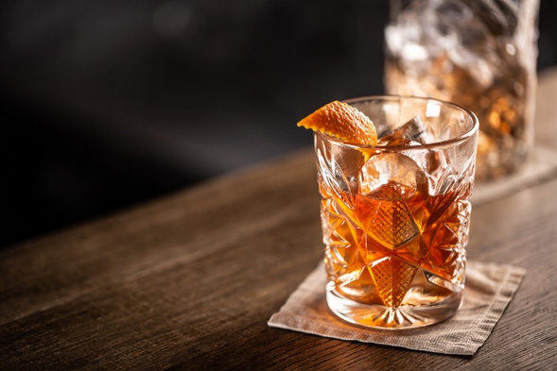

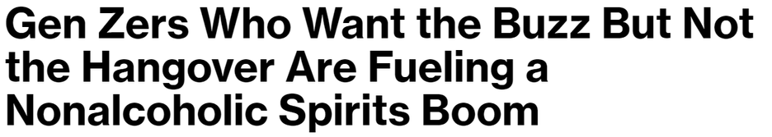


Big Picture
01
8.7%
Non-alcoholic spirit market expected to growth much faster and size of market to play looks promising
2022-31 CAGR growth expected in non-alcoholic spirts market worldwide
02
$3bn
Singapore alcoholic drinks market size growing by ~5.5%
75%, that is 2.3bn consumption thru out of home – Restaurants, bars etc.
03
- Bloomberg
$4bn
Singapore non-alcoholic drinks market size growing by ~2%; excl. hot drinks
50%, that is 2bn consumption thru out of home – Restaurants, café etc.

Slide 5


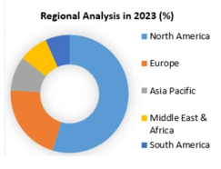

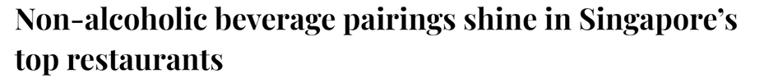

Big Picture
01
Increasing Demand for Healthy options in drinks markets
Growing trend around healthy options and Singapore consumers have ability to pay for premium and innovative non-alcoholic spirts
Headroom for growth
02
Growing Awareness about harmful effects of excessive alcohol consumption
03
Consumers willing to Pay for premium and innovative propositions
- Peak

Slide 6
Agenda
Big Picture – Non-alcoholic spirit market and macro scenario
Deep-dive: Scoping venues good fit for ‘Boozeless’
Top 20-25 priority venues for launch
Insights to marketing activities for roll-out

Slide 7
Screening criteria for selecting the restaurants for product reach
Parameter for Restaurant to: | Criteria
Reach the Targeted audience/ Consumers | Millennials - (constituting 43% and 36% of the consumer base for non-alcoholic spirts in the US and Australia GenZ – (First timers and future growth expected to be driven by GenZ consumers) Female population (Research studies have shown that Female population play much larger role in this segment) Gen X (Aspiring healthy lifestyle)
Be able to communicate Product proposition: | Taste, experience and buzz element Premium offering and presentation Trusted ingredients for healthy lifestyle
Deliver product offerings and has potential for growth | Fine dining restaurants incl. Michelin Star and chain of restaurants meeting consumer landscape Bars User rating more than 4 with minimum user review counts Leverage restaurants with strong footfall and good presence during evening busy hours
Meet geographical reach | Leverage strong presence of F&B in Central zone of Singapore to maximise revenue Limited presence in other zones of Singapore to expand reach – leveraging chains
Be brilliant at basics to support financials and supply chain metrics | Financial viability and tie up with restaurants for sustained growth Fixing supply chain metrics – incl. inventory, storage and any other specific requirements

Slide 8
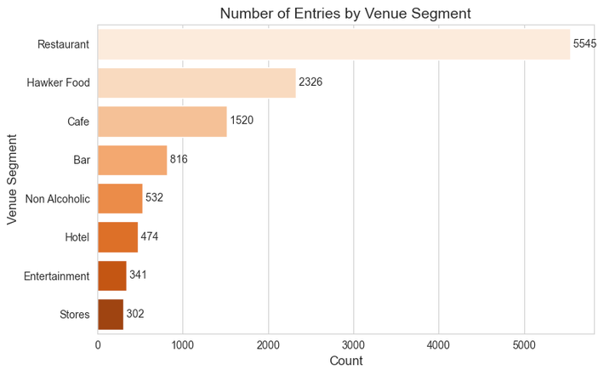

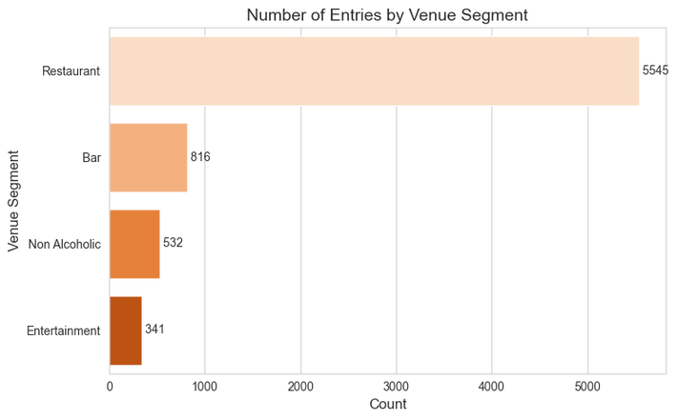
Venue Segment Distribution
Inital Distribution
Target Distribution
(Restaurants, Bars, Non Alcoholic Venues, and Entertainment)
As the first step of narrowing down our target venues, we identify the key venue types to target

Slide 9
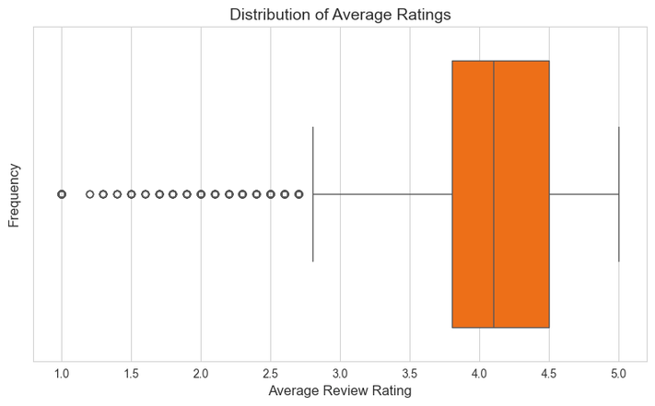
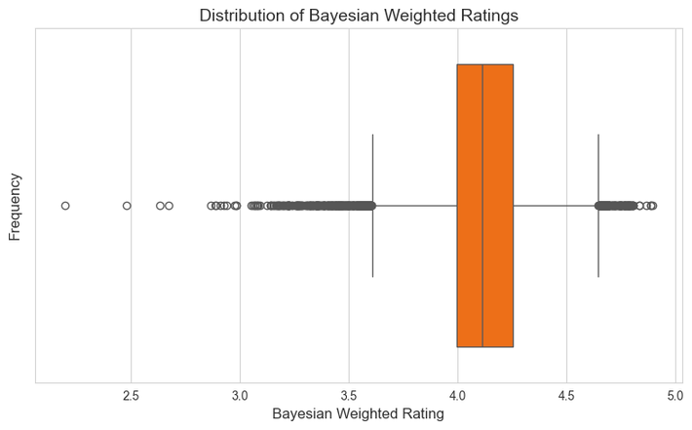
Bayesian Weighted Rating System
Inital Distribution
Improved Distribution
To increase usability of the review metric, we BPT to better map and predict average ratings for restaurants across the dataset

Slide 10
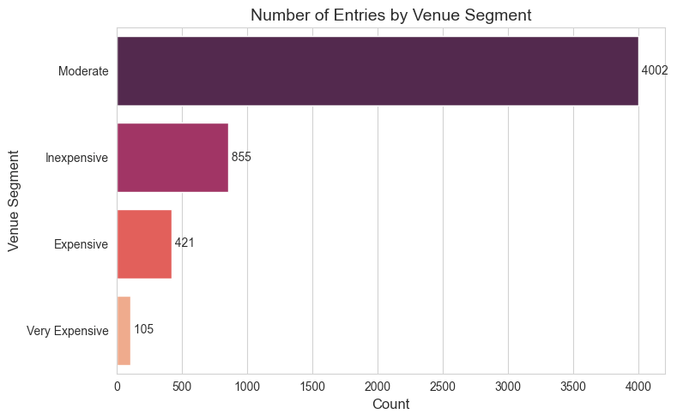
Price Point Distribution
An analysis of the price point distribution across remaining identified restaurants
Price Brackets:
0$-10$/pax Inexpensive
10$-25$/pax Moderate
25$-50$/pax Expensive
50$+/pax Very Expensive

Slide 11



Ranking of restaurants basis ‘Boozeless’ rating score
25
532 Restaurants meet all key criteria
1. Target audience 2. Rating 3. Price point 4. Ambience
5. Qualitative review score 6. Busy hours 7. Regional and others
Phase I
Size of
Market
507
Price point basket relevant for high end consumers; 4852 restaurants
Fall below $, $$ – excluded for phase I
Phase II
4852
Out of 7234 restaurants – only 5384 restaurants
have rating >4 and brand image
1850
Venue Segment not relevant to the target audience
7234 restaurants is the relevant universe, incl.
Fine dining, Bars, entertainment, Non-alcholic
4652
11886
Number of Restaurants

Slide 12
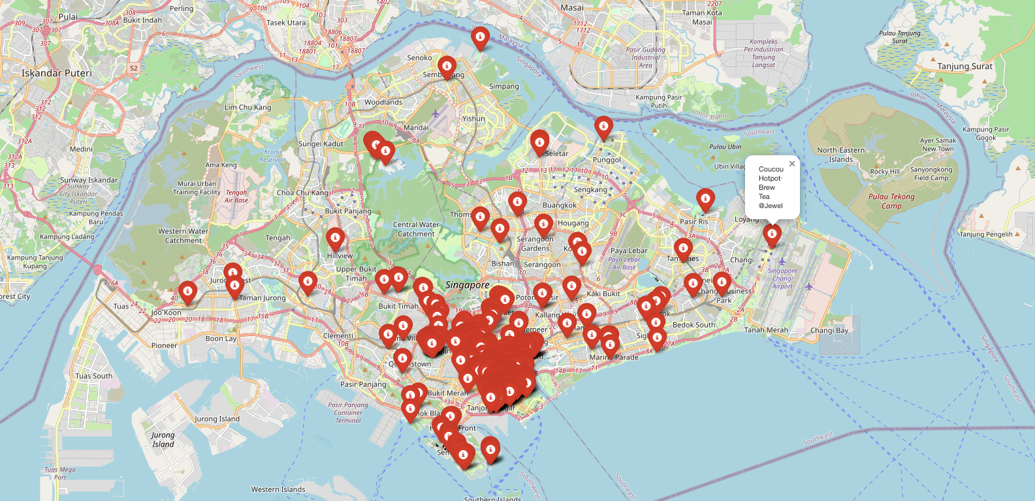
~532 Restaurants defining Market Size

Slide 13

‘Boozeless’ Score to refine it to Top 25:
User rating and weightage of qualitative comments into the rating
Venue Segments
Fine Dining, Bar, Entertainment meeting the criteria for experience
BOOZELESS SCORE
Target Audience Criteria
Milinneals, GENZ, Female, GEN X and Footfall
Ambience and Unique Menu and other key factors

Slide 14



Ranking of restaurants basis ‘Boozeless’ rating score
 | Target Audience | Rating | Price Point | Ambience | Qualitative Rating
STATUS

Slide 15
Agenda
Big Picture – Non-alcoholic spirit market and macro scenario
Deep-dive: Scoping venues good fit for ‘Boozeless’
Top 20-25 priority venues for launch
Insights to marketing activities for roll-out

Slide 16

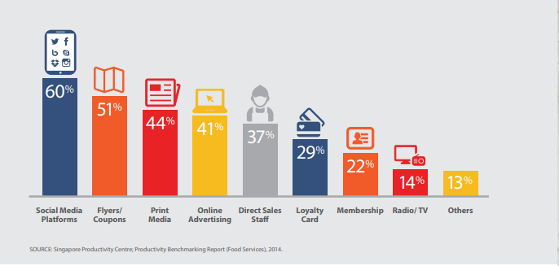





Launch and Marketing activities
Social Media campaigns, Leveraging Tech apps and presenting the product proposition an upgrade is key to create demand
Write the first KPI here.
Briefly elaborate on the KPI.
Source: Singapore Productivity Benchmark report
Leverage brand focus Content and material social media digital campaigns to drive reach
Liaison with Restaurants to present product as an upgrade to drive premiumisation and consumer pull
Leverage technology ( e.g. SEO) to reach target audience Millennials, GenX, Females
Capitalise consumer base on Food Tech applications

Slide 17





Launch and Marketing activities
Influences, Leveraging Experts and creating awareness through various channels will be effective in driving productivity from media campaigns
Write the first KPI here.
Briefly elaborate on the KPI.
Leverage brand focus Influencers campaigns to drive reach
Awareness on Health benefits through Expert podcasts or other campaigns
Presence in related Social Events, In-flight entertainment to drive relevance and consideration
Blog posts and presence in Food and Gourmet magazines

Slide 18
GO
Company Name
In Singapore
| Thanks!!
JYOTIT KAUSHAL

